Slide 1

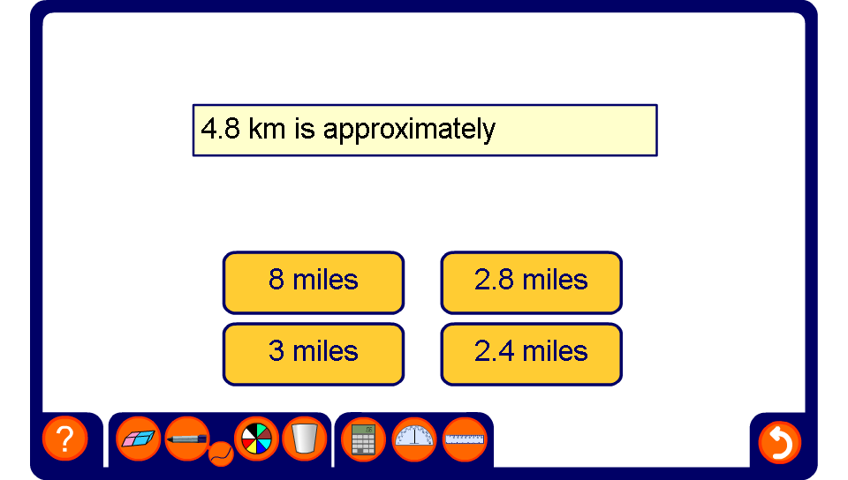


Metric and imperial conversions

